Slide 1
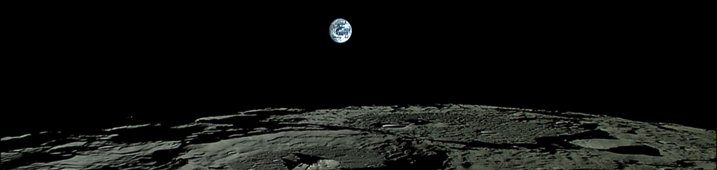



Improving Lunar Crustal Magnetic Field Maps in the South Polar Region
Image Credit: Kaguya Orbiter
Intern: Aaron Rex McCray
Mentor: Dr. Lon Hood, Lunar Planetary Laboratory
Symposium: SkySong ASU Scottsdale Innovation Center, Scottsdale, AZ
Date: April 19th, 2025

Slide 2
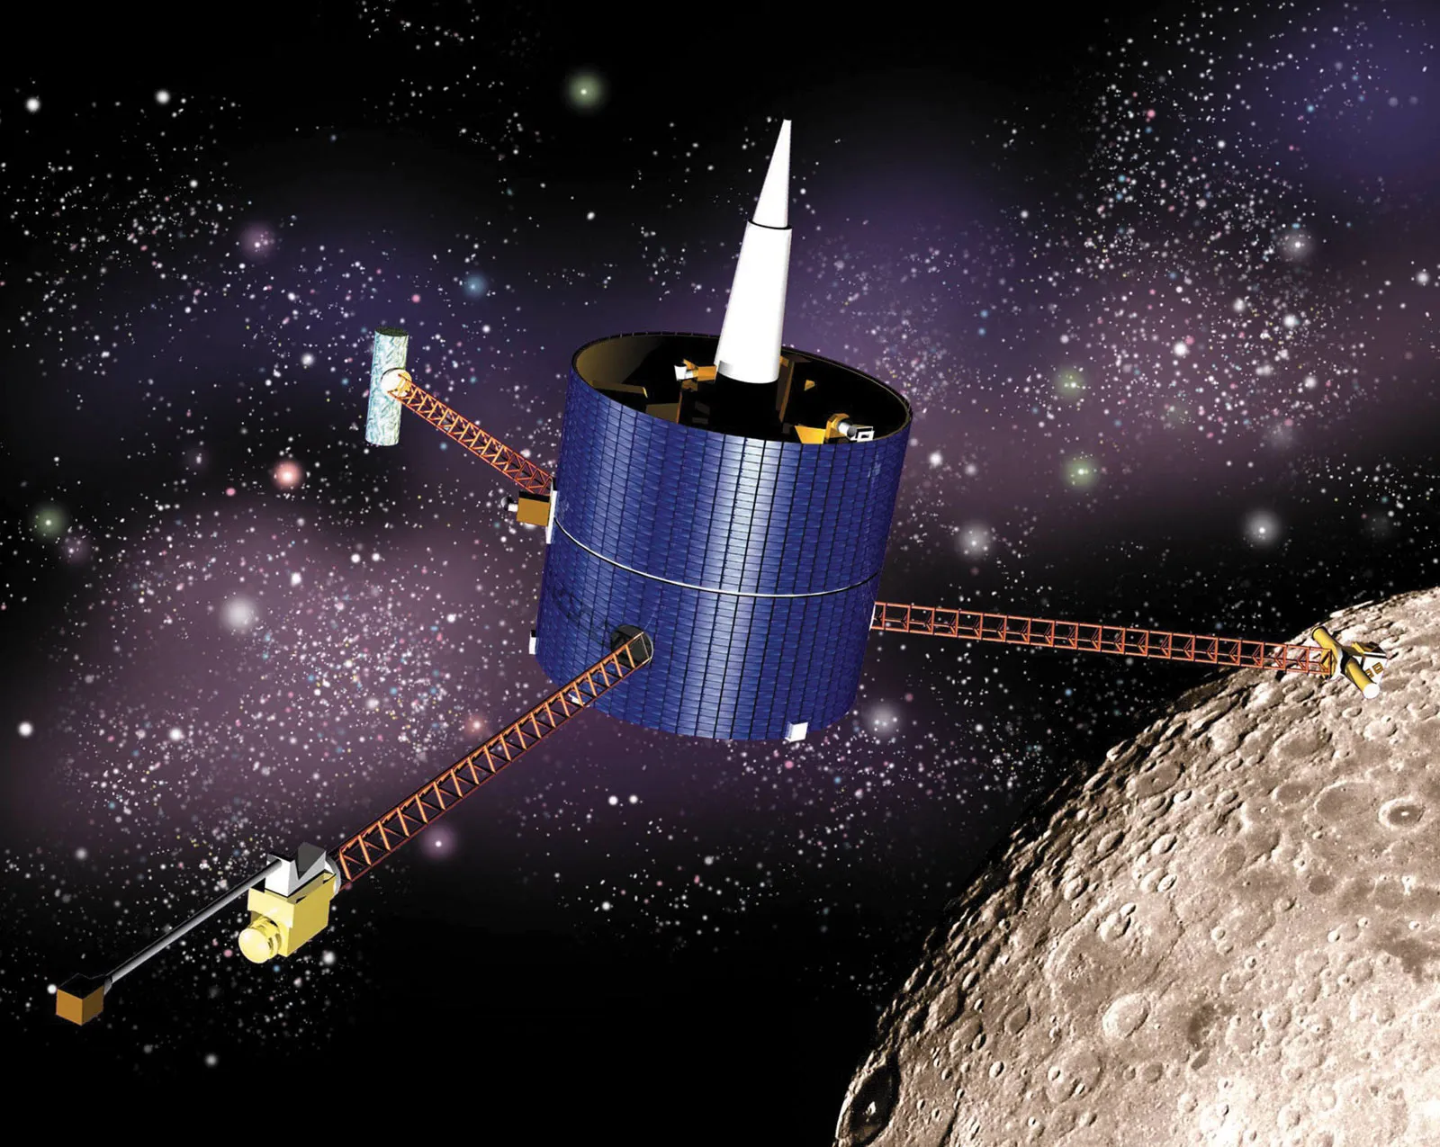
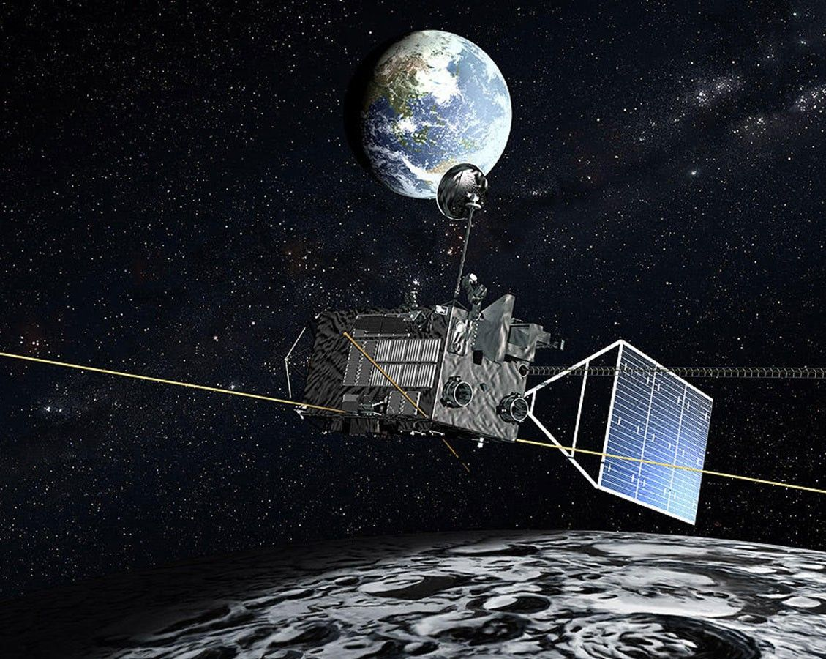
Data Sources
Lunar Prospector (January 1998 – July 1999)
Kaguya (October 2007 – June 2009)

Slide 3
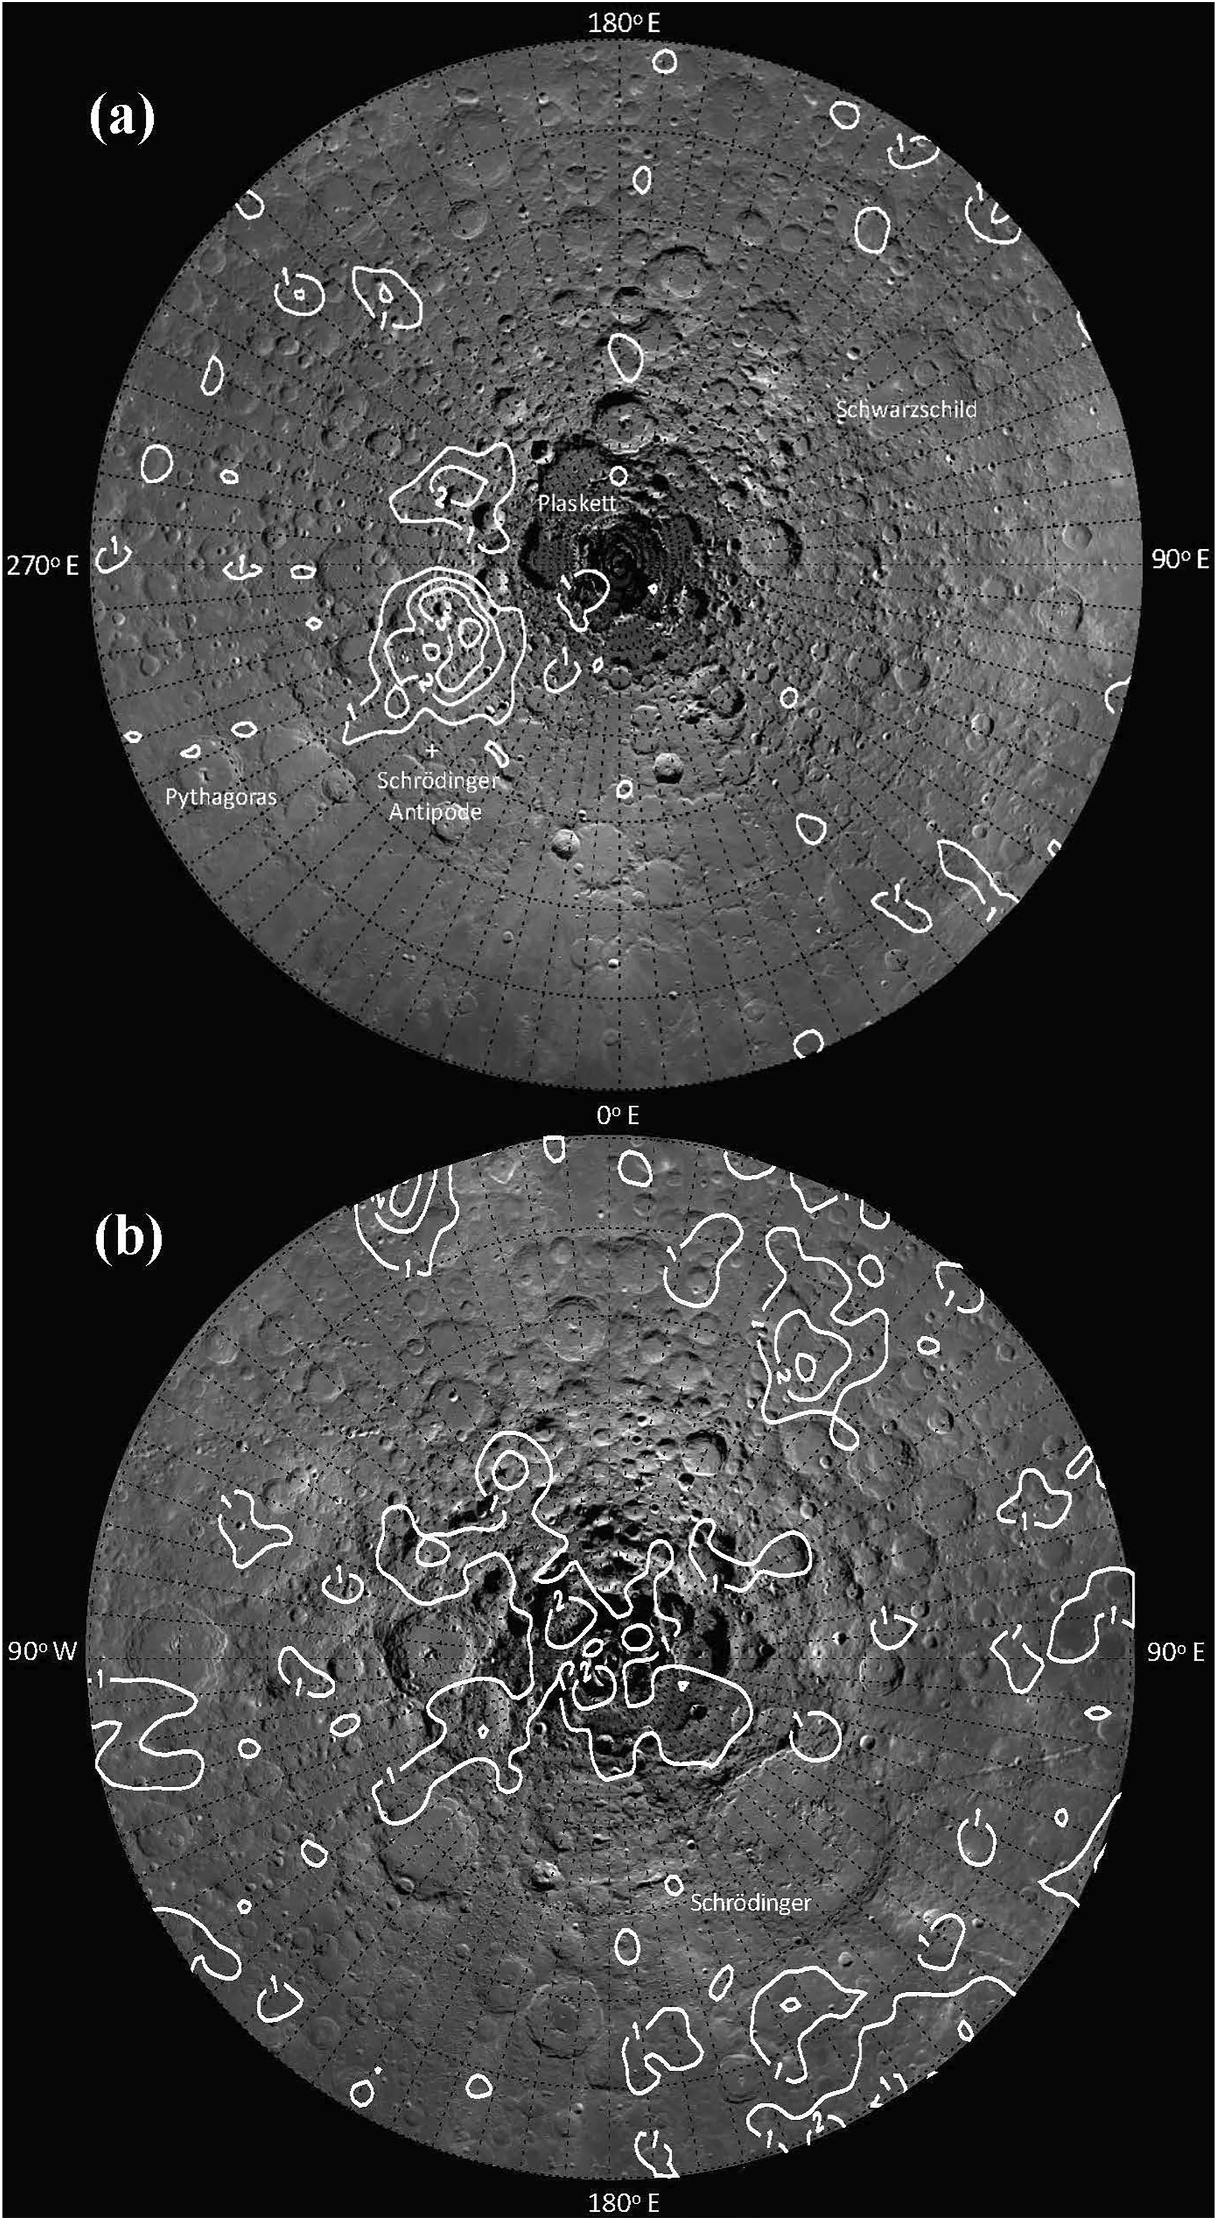
What is the lunar crustal magnetic field?
3
North Polar Region
South Polar Region
Credit for Images: Hood et al. 2022

Slide 4
Earth vs. Moon Magnetic Field Comparison
4
Earth
  Global magnetic field generated by a molten iron core (dynamo effect)
  Up to ~65,000 nanoteslas
  Provides a protective shield against solar wind and cosmic radiation
Moon
  Localized crustal magnetic anomalies
  Can be hundreds of nanoteslas at the surface.
  Provides almost no protection from the solar wind except for strong anomalies or weaker anomalies near the poles

Slide 5
Developing a Model
We use Fortran programs that model local regions of the lunar south pole.
The modeling process uses a 61×61 grid of equivalent dipoles spaced 0.67° apart in latitude and longitude.
  The dipoles are set at a specific distance below the lunar surface. These depths can be adjusted to improve accuracy.
  The magnetic field at the spacecraft’s location is the sum of all the dipole magnitudes at that position.
  The strength of the dipole moments are adjusted over the course of 60 iterations in order to best match the observed data without adding unrealistic field variations.

Slide 6
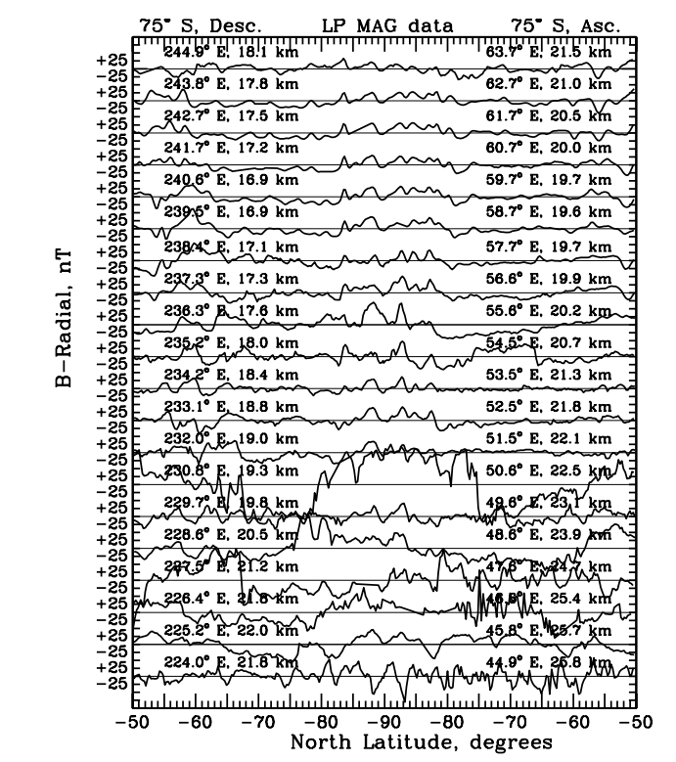
Data Selection &
Noise Reduction
These stackplots represent the magnetometer data taken from the orbiters, measured in nanoteslas (nT). Orbits are chosen through visual analysis.
Reliable Data:
Smooth and Consistent
Unreliable Data: Noisy
and inconsistent

Slide 7
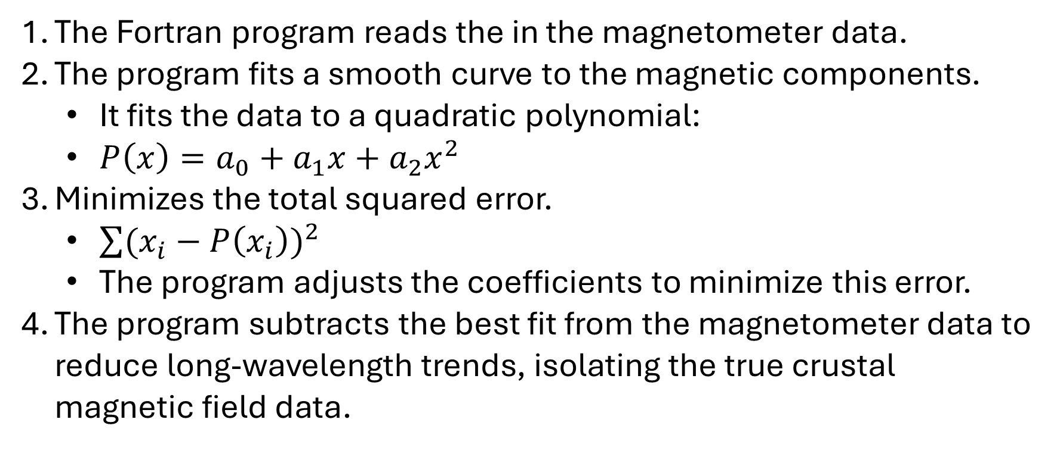
Long-Wavelength Detrending
7
The Fortran program reads the in the magnetometer data.
The program fits a smooth curve to the magnetic components.
  It fits the data to a quadratic polynomial:
  $P\left(x\right)=a_{0}+a_{1}x+a_{2}x^{2}$
Minimizes the total squared error.
  $\sum{{(x_{i}−P\left(x_{i}\right))}^{2}}$
  The program adjusts the coefficients to minimize this error.
The program subtracts the best fit from the magnetometer data to reduce long-wavelength trends, isolating the true crustal magnetic field data.

Slide 8
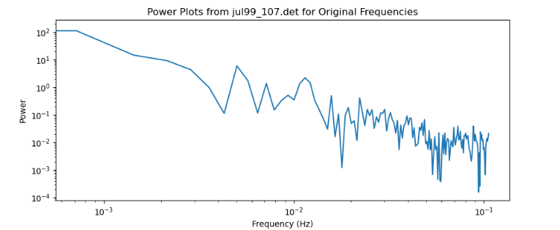
Visualization: Before Detrending
8
This is a power spectrum of the magnetometer data before detrending.
Power Plot of Orbit 107 for the Original Frequencies
Power
Frequency (Hz)

Slide 9
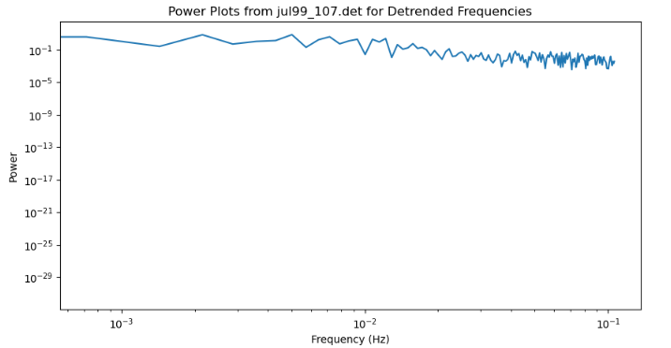
Visualization: After Detrending
9
Power Plot of Orbit 107 for the Detrended Frequencies
This is a plot of the power spectrum after detrending. The long-wavelength components have been significantly reduced.
Power
Frequency (Hz)

Slide 10
Detrending Modification
10
I updated the detrending program to fit the data to a cubic polynomial instead of a quadratic polynomial.
This allows for better modeling of long-wavelength trends in the data. This can help reduce artificial lineation and improve the accuracy of the maps when the best-fit curve is subtracted from the magnetometer data.

Slide 11
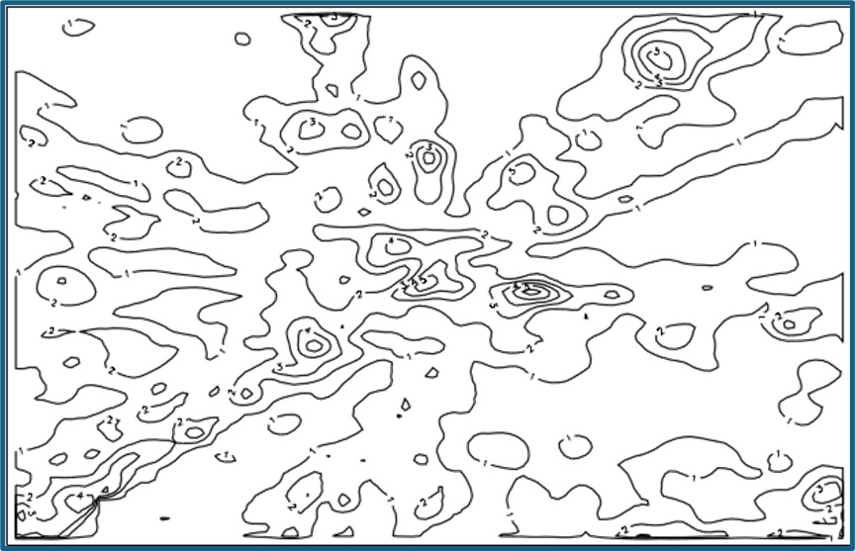
Results: Before Selection and Detrending (20 km)
11
This is a map generated using orbit selections from before I started updating the dataset and modifying the detrending program.
90°W
90°E

Slide 12
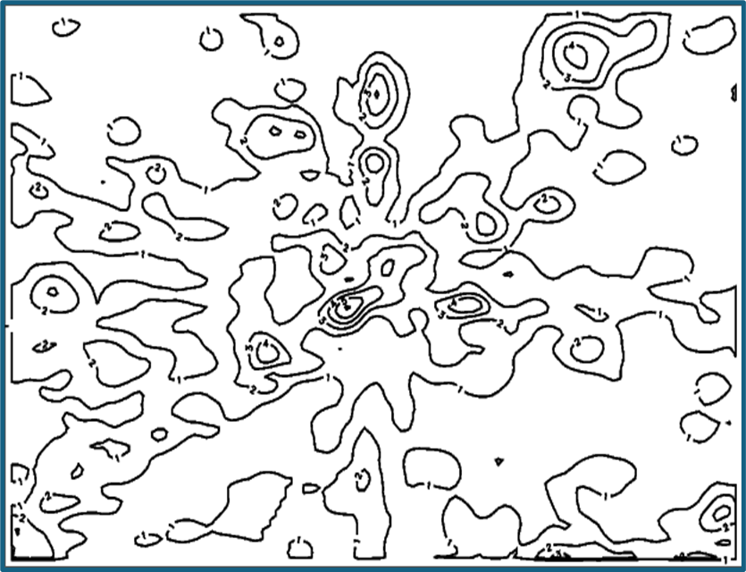


Results: After Detrending Modification (20 km)
12
This map was produced after reselecting orbits and modifying the detrending program to include cubic terms, reducing external contamination long-wavelength trends.

Slide 13
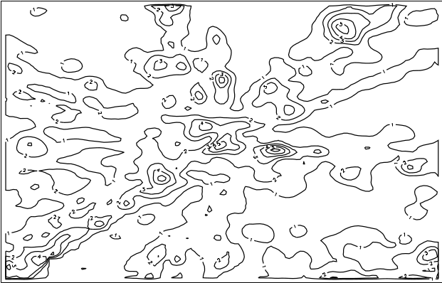
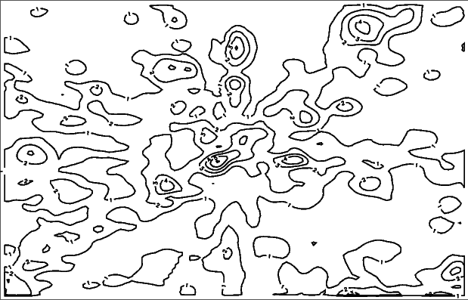
Results: Side-by-Side Comparison
13

Slide 14
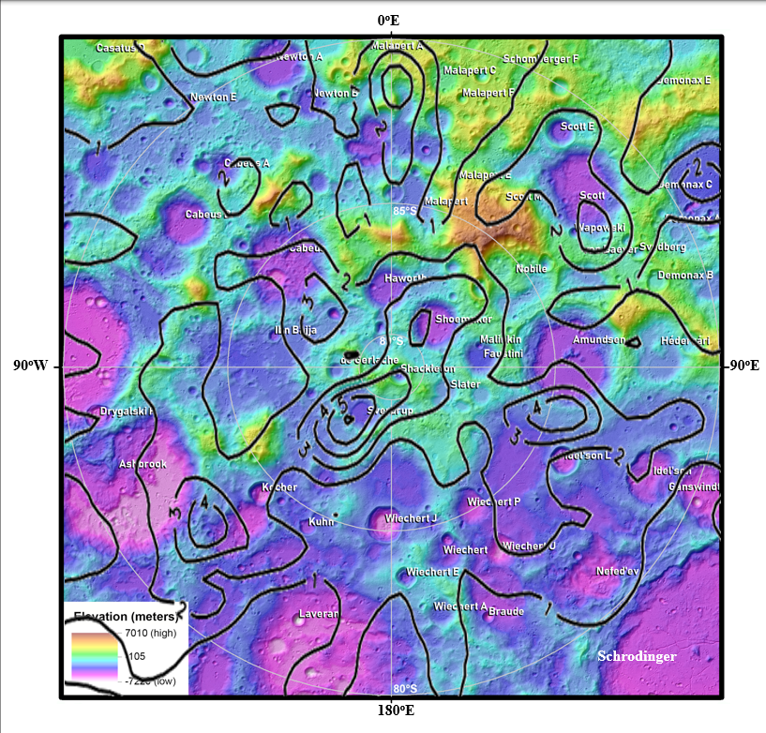
Final Map
This is the final map, overlayed over the topography for the south polar region from 75°S to 90°S.
We can use maps like this to discern which permanently shadowed regions (PSRs) on the lunar surface might be more abundant with water-ice, since those water-ice deposits may be protected from solar wind ion-sputtering due to stronger crustal fields.

Slide 15
Future Research
15
Further detrending modifications
  Fitting Data to Higher Order Polynomials
Updated Orbit Selection
  Accounting for High-Frequency Noise
Experimental Research
  Researching solar wind ion sputtering on the lunar surface.

Slide 16
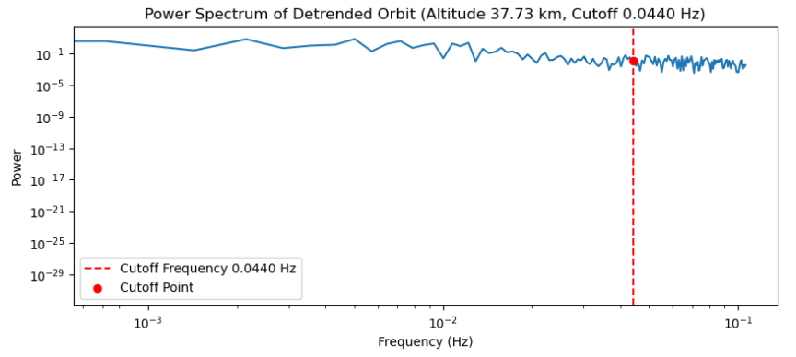
Possible Method: Updated Orbit Selections
16
We can use the altitude and velocity of the spacecraft to determine the maximum frequency of the real data.

Slide 17


Contributors
17
Dr. Lon Hood, University of Arizona, Lunar Planetary Laboratory
Michelle Coe, University of Arizona, Lunar Planetary Laboratory
Fiona Rogers, University of Arizona
Catherine Snyder, University of Arizona
Gineka Mena, University of Arizona
The Arizona Space Grant Consortium
The Lunar Planetary Laboratory (LPL)

Slide 18
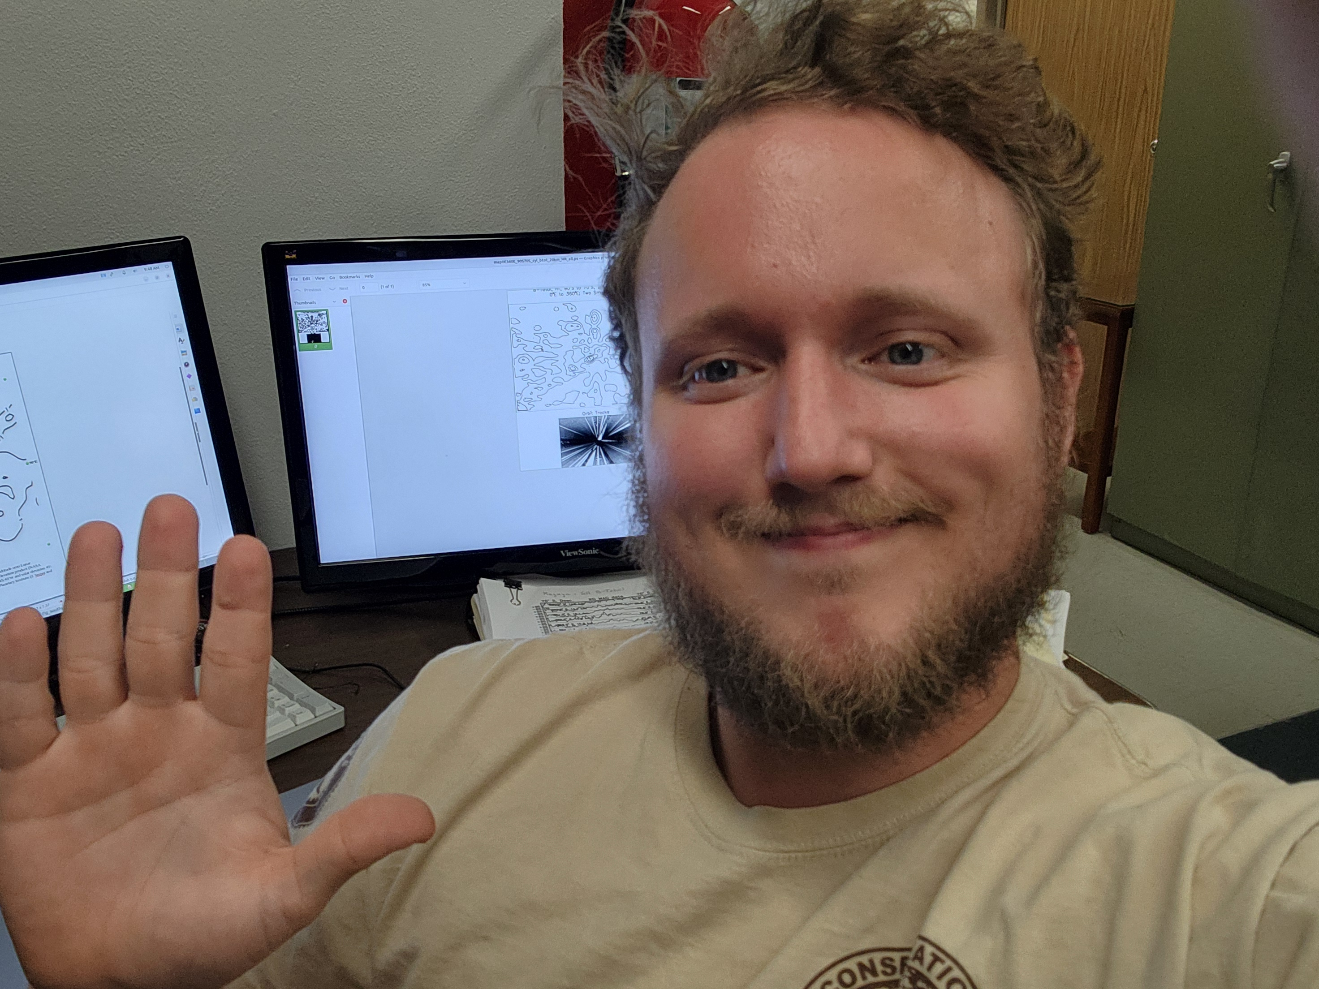
Thank you!

